Slide 1

Mass Spectrometry Algorithms
April, 2019

Slide 2
Mass spectrometry
Mass spectrometry (MS) is an analytical technique that ionizes chemical species and sorts the ions into a spectrum based on their mass-to-charge ratio. In simpler terms, a mass spectrum measures the masses within a sample

Slide 3
Peptide Spectrum
AA | G | A | S | P | V | T | C | I | L | N | D | K | Q | E | M | H | F | R | Y | W
Mass | 57 | 71 | 87 | 97 | 99 | 101 | 103 | 113 | 113 | 114 | 115 | 128 | 128 | 129 | 131 | 137 | 147 | 156 | 163 | 186
REDCA
RE - DCA
RED - CA
Fragment | “” | R | RE | RED | REDC | REDCA | EDCA | DCA | CA | A
Mass | 0 | 156 | 285 | 400 | 503 | 574 | 418 | 289 | 174 | 71
Ideal Spectrum(“REDCA”) = [0, 71, 156, 174, 285, 289, 400, 418, 503, 574]

Slide 4
Peptide Spectrum
Ideal Spectrum(“REDCA”) = [0, 71, 156, 174, 285, 289, 400, 418, 503, 574]
R
E
D
C
A
0
71
156
174
285
289
400
418
503
574
A
C
D
E
R
Ideal Spectrum(?) = [0, 57, 114, 128, 215, 229, 316, 330, 387, 444]
N
A
T
T
T
T
A
N
0
G
57
G
114
128
S
215
229
S
316
330
G
387
G
444
K/Q
D
D
K/Q

Slide 5
Real Spectrum Analysis
Not all fragments are present
False masses
Different intensities
Ions modification
D
K/Q
https://www.researchgate.net/figure/Mistranslated-A-pernix-proteins-Total-protein-mass-spectrometry-spectra-with_fig1_286636933

Slide 6
Peptide Scoring
X
4
Y
5
AA | X | Z | Z | X | X
Prefix | 4 | 9 | 14 | 18 | 22
Suffix | 22 | 18 | 13 | 8 | 4
Mass | 1 | 2 | 3 | 4 | 5 | 6 | 7 | 8 | 9 | 10 | 11 | 12 | 13 | 14 | 15 | 16 | 17 | 18 | 19 | 20 | 21 | 22
Intensity | 0 | 0 | 0 | 3 | 8 | 7 | 2 | 1 | 100 | 0 | 1 | 4 | 3 | 500 | 2 | 1 | 3 | 9 | 1 | 2 | 2 | 0
Intensity count = 3 + 3 + 1 + 100 + 3 + 500 + 9 + 9 + 0 + 0 = 628
Shared peaks count (5) = 4

Slide 7

Peptide Scoring
X
4
Y
5
AA | X | Z | Z | X | X
Prefix | 4 | 9 | 14 | 18 | 22
Suffix | 22 | 18 | 13 | 8 | 4
Mass | 1 | 2 | 3 | 4 | 5 | 6 | 7 | 8 | 9 | 10 | 11 | 12 | 13 | 14 | 15 | 16 | 17 | 18 | 19 | 20 | 21 | 22
Peptide | 0 | 0 | 0 | 1 | 0 | 0 | 0 | 0 | 1 | 0 | 0 | 0 | 0 | 1 | 0 | 0 | 0 | 1 | 0 | 0 | 0 | 1
Spectral | 0 | 0 | 0 | 4 | -2 | -3 | -1 | -7 | 6 | 5 | 3 | 2 | 1 | 9 | 3 | -8 | 0 | 3 | 1 | 2 | 1 | 0
$$Score\left(Peptide, Spectrum\right)=p1 × s1+ …+pm × sm$$

Slide 8
Peptide Sequencing Algorithm
Construct a DAG from Spectral vector:
Add a node for each mass
Connect node i to node j if (j – i) is equal to AA mass
Assign vector value as weight to each node
Find a path with a maximum weight in this DAG

Slide 9
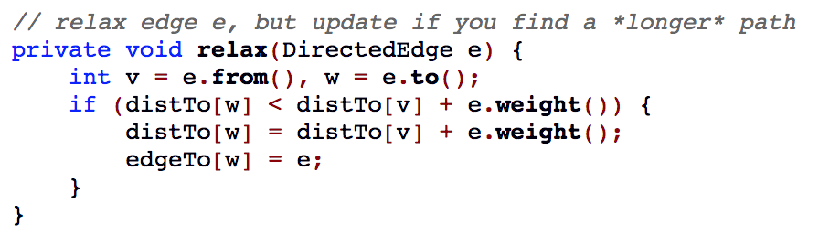
Longest Path in a DAG
Create topological sort of a graph
Starting from a source for each outgoing edge:

Slide 10
Longest Path in a DAG

Slide 11
Peptide Identification
Peptide identification problem:
Find a peptide from a proteome with a maximum score against a spectrum
Peptide spectrum match (PSM) problem:
Identify all peptide-spectrum matches scoring above a threshold for a set of spectra and a proteome
Consider false discovery rate (FDR) against a decoy proteome

Slide 12
Infinite monkey theorem
The infinite monkey theorem states that a monkey hitting keys at random on a typewriter keyboard for an infinite amount of time will almost surely type any given text, such as the complete works of William Shakespeare.

